Slide 1
Making Cloud Real
Turning Disruption into Opportunity
Scott Crenshaw
VP & GM, Cloud Business Unit
Red Hat
June 8, 2011
Twitter: @SCrenshaw

Slide 2
3

Slide 3
$26,000,000,000
$26,000,000,000
4%

Slide 4
2012
20%
0

Slide 5
79%

Slide 6
75%

Slide 7
100%

Slide 8
2

Slide 9
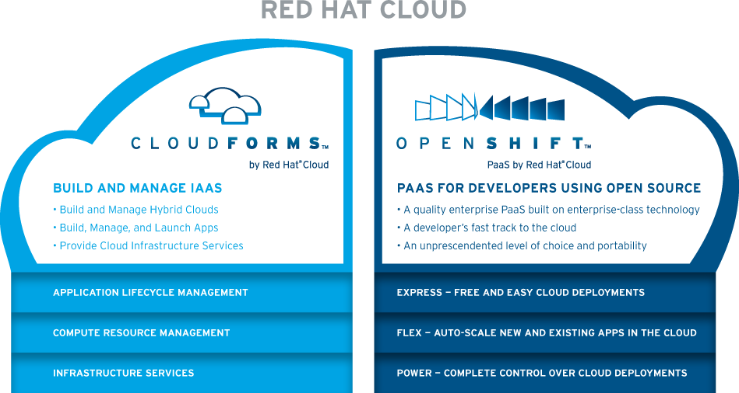

Slide 10
1

Slide 11


Slide 12


Slide 13


Slide 14
3
3

Slide 15

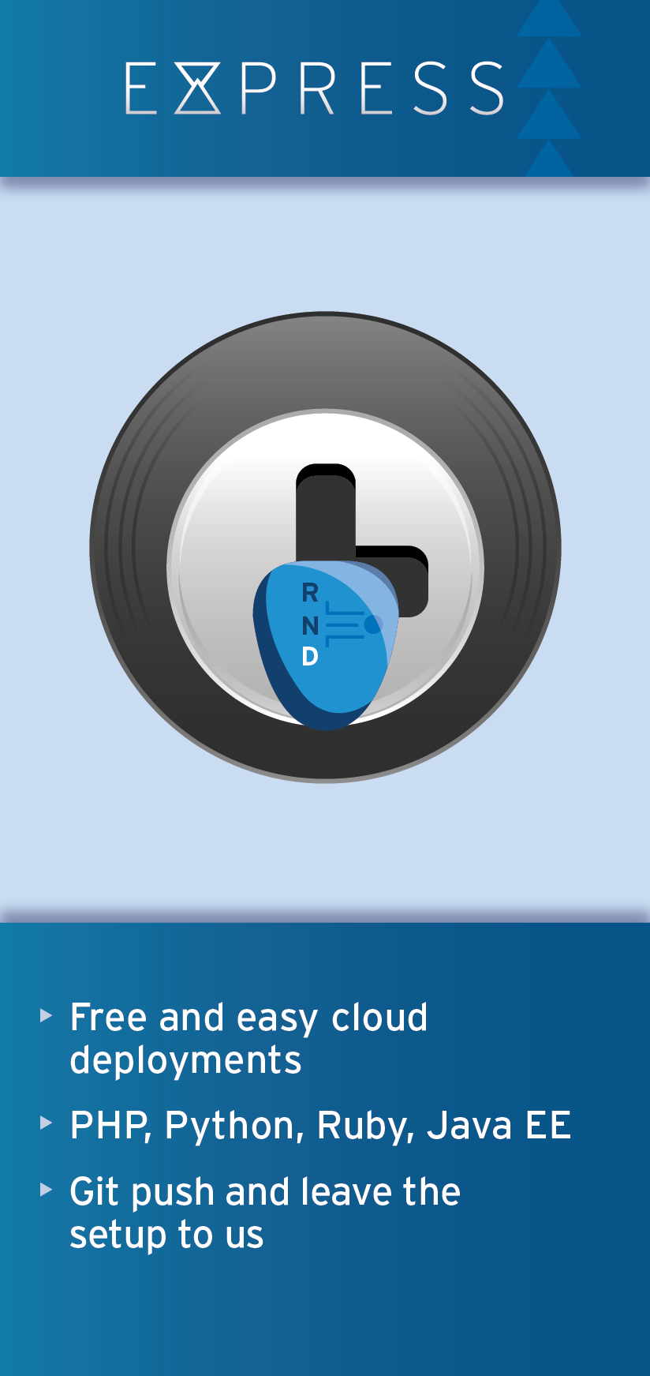
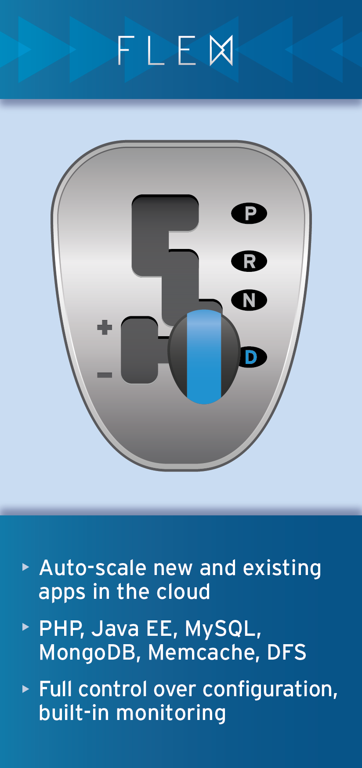
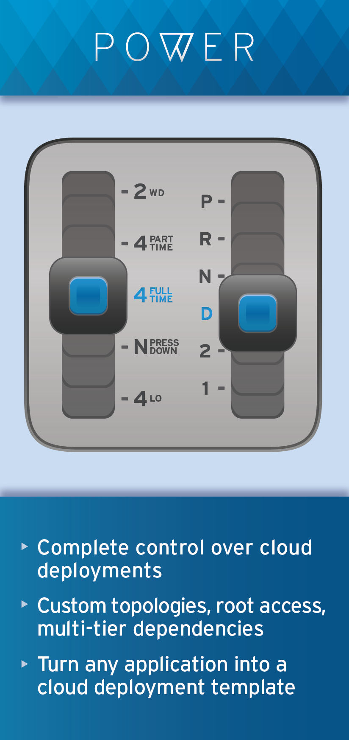
OpenShift Offerings

Slide 16

Framework Innovation
  The latest coolest languages & tools
Choice of Cloud
  Don't be locked in to an IaaS
Source Middleware
  Applications will run anywhere

Slide 17
3
3

Slide 18
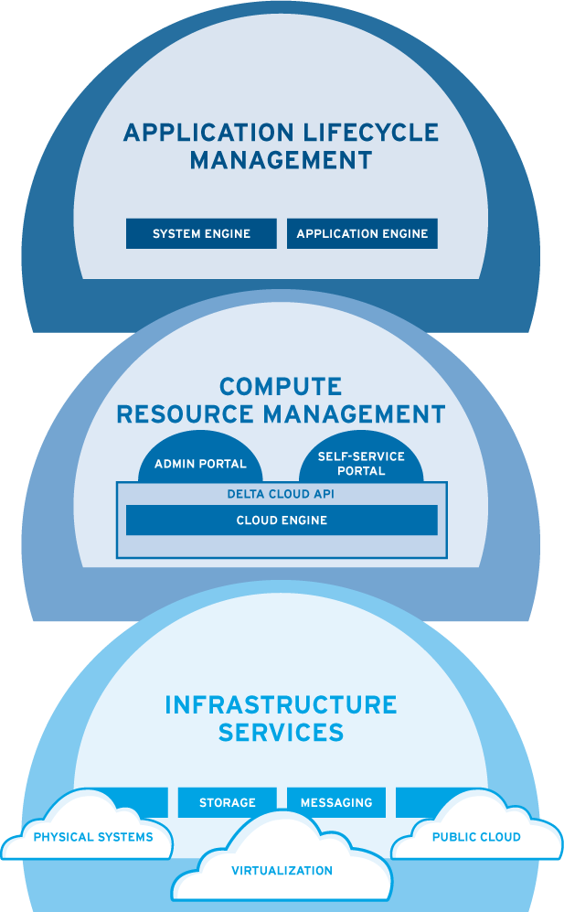

CLOUDFORMS REDEFINES IAAS
Notes:
And this same system manages public cloud capacity, the same as internal. Allowing you to use any Certified Cloud Provider as if it were an internal cloud. Seamlessly.

Slide 19
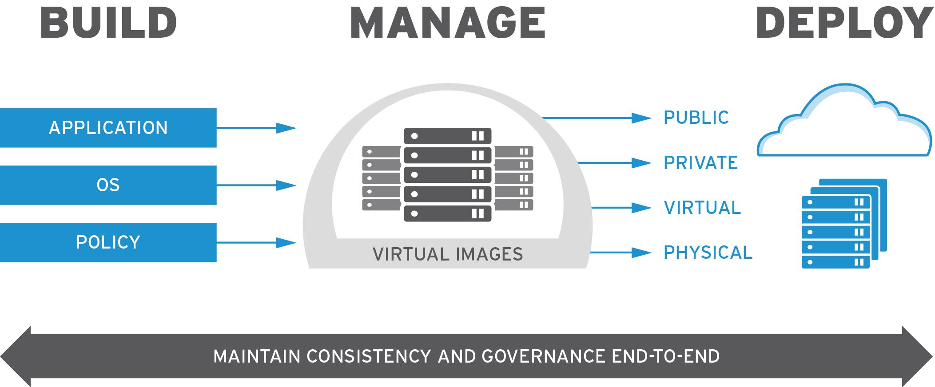
BRING YOUR APPLICATIONS INTO THE CLOUD

Slide 20
10

Slide 21
Red Hat Will Enable Your Success
The industry's most compelling
solution portfolio
  OS, virtualization, IaaS, enterprise middleware, PaaS
Open source needed to realize
the benefits of cloud
  Manages, simplifies clouds built
  from many vendors' technologies
  Easily integrates with legacy environments
  Easier migration to cloud, at the pace and risk profile to fit each customer
  More choice, less lock-in
Build clouds from any type of server
  Physical, virtual, public cloud
Manage the applications, not sprawling virtual machines
Build better applications, faster,
with OpenShift
A large set of reference architectures
to make you the cloud expert
A rich portfolio of service templates
to make you the cloud expert
Cloud training to make you the
cloud expert
Exciting, relevant marketing to
entice customers to come to you

Slide 22
1

